Slide 1
Team ‘Lime’
Telerik Academy
WEB SERVICES
AND
CLOUD TEAM PROJECT

Slide 2

Team ‘Lime’ Presents
ThinkShare
The new creative forum for sharing your thoughts, ideas and many more…

Slide 3
Team Members
epitsin ( Елена Пицин )
julia.meleshko ( Юлия Мелешко )
TeodorTunev ( Теодор Тунев )
bankoff ( Йордан Банков )
archangelmichael ( Ради Шикеров )
ivandanov ( Иван Данов )
bangiev ( Иван Бангиев )

Slide 4
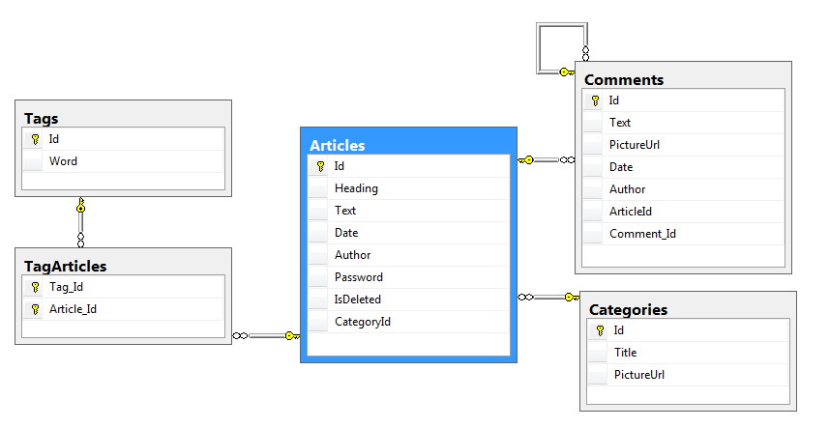
Project Database Diagram

Slide 5
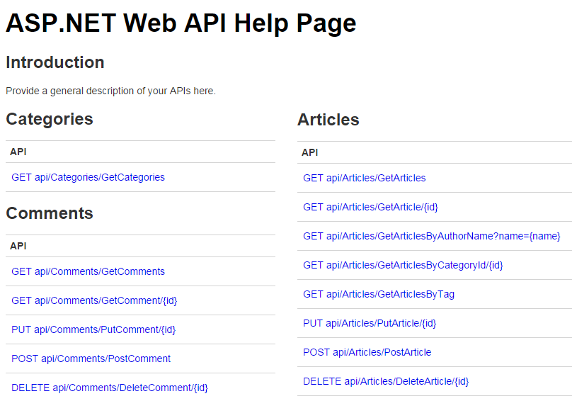
List of Provided Services

Slide 6
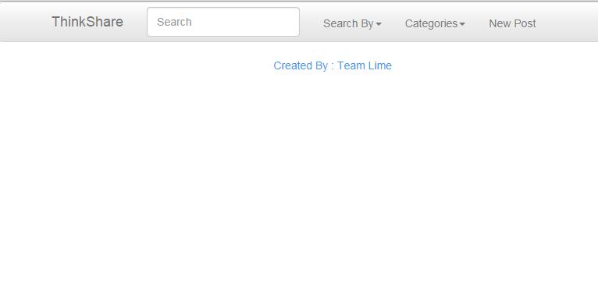
Our Web Client

Slide 7

Thank You For Your Attention
GITHUB : https://github.com/ThinkShare

